Slide 1
APOLOGETICS
IN ONE LESSON
almost
Ai1L.net
Lesson 11
Evidence for God that Everyone Has (Romans 1:18-23)

Slide 2
Summarize Romans 1:18-23
1

Slide 3
“﻿﻿﻿Even in intellectual and academic circles, atheism did not become respectable until about 1870 or so, little more than a century ago, and it continued to be restricted to small numbers of intellectuals”
PAUL C. VITZ
Faith of the Fatherless: The Psychology of Atheism
Notes:
Vitz, Paul C.. Faith of the Fatherless: The Psychology of Atheism . Ignatius Press. Kindle Edition.

Slide 4
“﻿﻿the known unbelievers of Europe and America before the French Revolution [1789] numbered fewer than a dozen or two. For disbelief in God remained scarcely more plausible than disbelief in gravity.”
JAMES TURNER
Without God, without creed, (page 5)

Slide 5
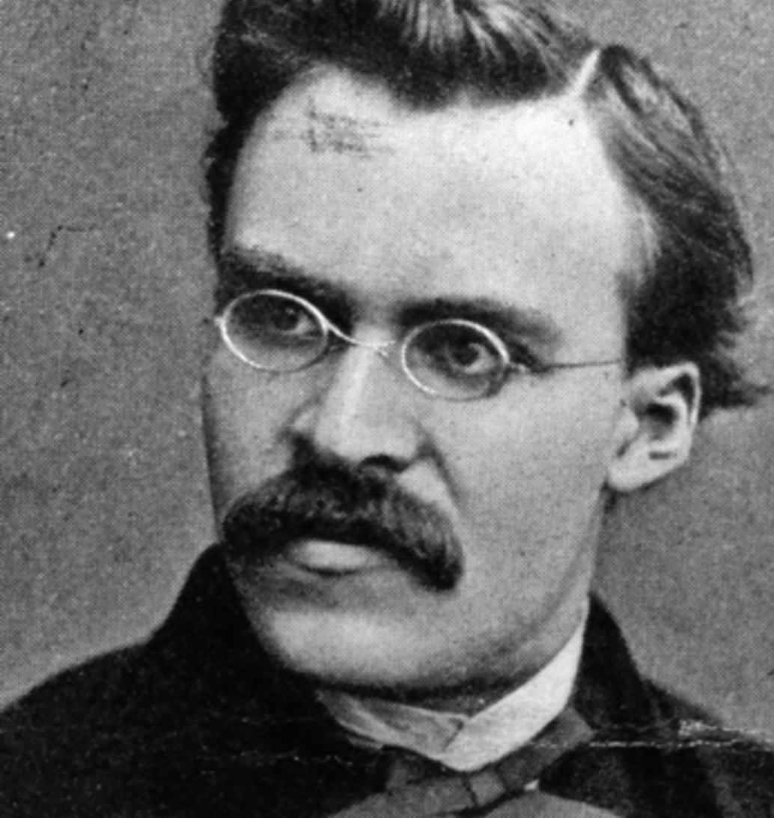
“I have absolutely no knowledge of atheism as an outcome of reasoning, still less as an event; with me it is obvious by instinct.”
FRIEDRICH NIETZSCHE Ecce Homo (page 51, translated by R. J. Hollingale)

Slide 6
“﻿None other than Aldous Huxley singled out sexual license as the chief immediate benefit to be derived from agreeing with the Origin [of Species].”
Stanley L. JAKI The Savior of Science (page 124)

Slide 7
Give examples of the “invisible attributes” that Paul says point to God
2

Slide 8
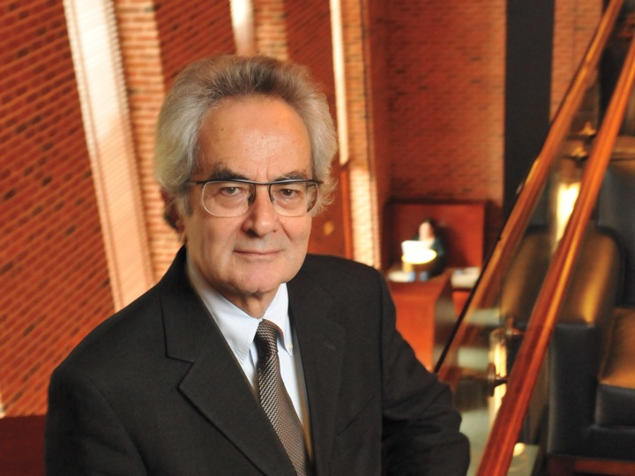
“﻿the coming into existence of the genetic code—an arbitrary mapping of nucleotide sequences into amino acids, together with mechanisms that can read the code and carry out its instructions— seems particularly resistant to being revealed as probable given physical law alone.”
THOMAS NAGEL
Mind and Cosmos, page 10

Slide 9
“﻿But can it be that those things which are most important and most essential for happiness do not call for intelligence, not have any part in the processes or reason and forethought?”
PLUTARCH
De Fortuna, 5

Slide 10
Give an argument for God’s existence
3

